Slide 1






PRESENTATION 2026
Pay Lens – visualising salary truth by AI & BI
Mentor Name
Student Name
Student Email
R. Umamaheshwari
Sneha khandelwal
Snehakhandelwal666@gmail.com

Slide 2

Outline
Abstract of the Project
Problem Statement
Proposed Solution
System Architecture
Live Demo of the Project
Embedded Video of Project
Conclusion
Future Scope

Slide 3
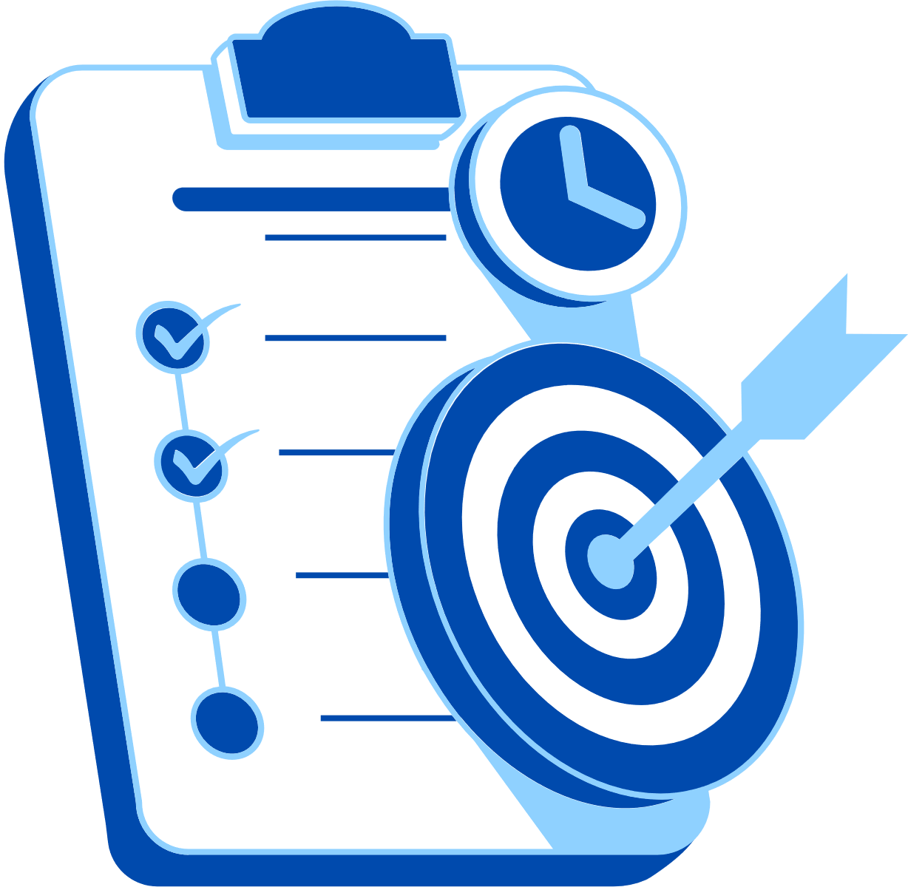
Abstract
Problem - Complexity of Payroll system, lack of clarity, overtime compliance & benchmarking.
Purpose - Building digital system combining tools, bridging gaps.
Tools – excel, power BI, copilot studio, AI assistant, streamlit.
Expected – structured dataset with AI& BI augmented framework.
Solving problem for employees and employer.

Slide 4

Problem Statement
Information asymmetry.
Ensuring overtime compliance monitoring.
Equity benchmarking.
Significant as poor payroll transparency cause fairness issue, legal risk, employee distrust, salary disputes.
Affected user – HR, Blue collar & Gig Workers, Management.

Slide 5
Problem Statement
Limitation of existing tools:
Underutilized AI skills.
Benchmarking often outsourced.
Scope :
Payroll transparency, pay equity benchmarking, overtime compliance verification, and financial literacy for employees.
Limitation
Real – time integration & advanced ML Models

Slide 6

Proposed Solution
A digital Payroll solution, PAY-LENS proposed to enhance compensation transparency, automate discrepancy detection, compliance monitoring, employee accessibility.

Slide 7
Proposed Solution
Excel - structuring solves complexity.
Power BI – analytical modelling
Copilot – assistant
Agent & chatbot – employee facing tool for communication.
Employee and Employer friendly.
Extension of Web application using streamlit.

Slide 8
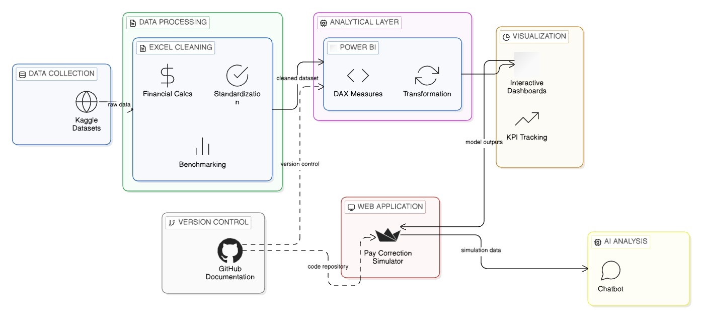
System Architecture

Slide 9
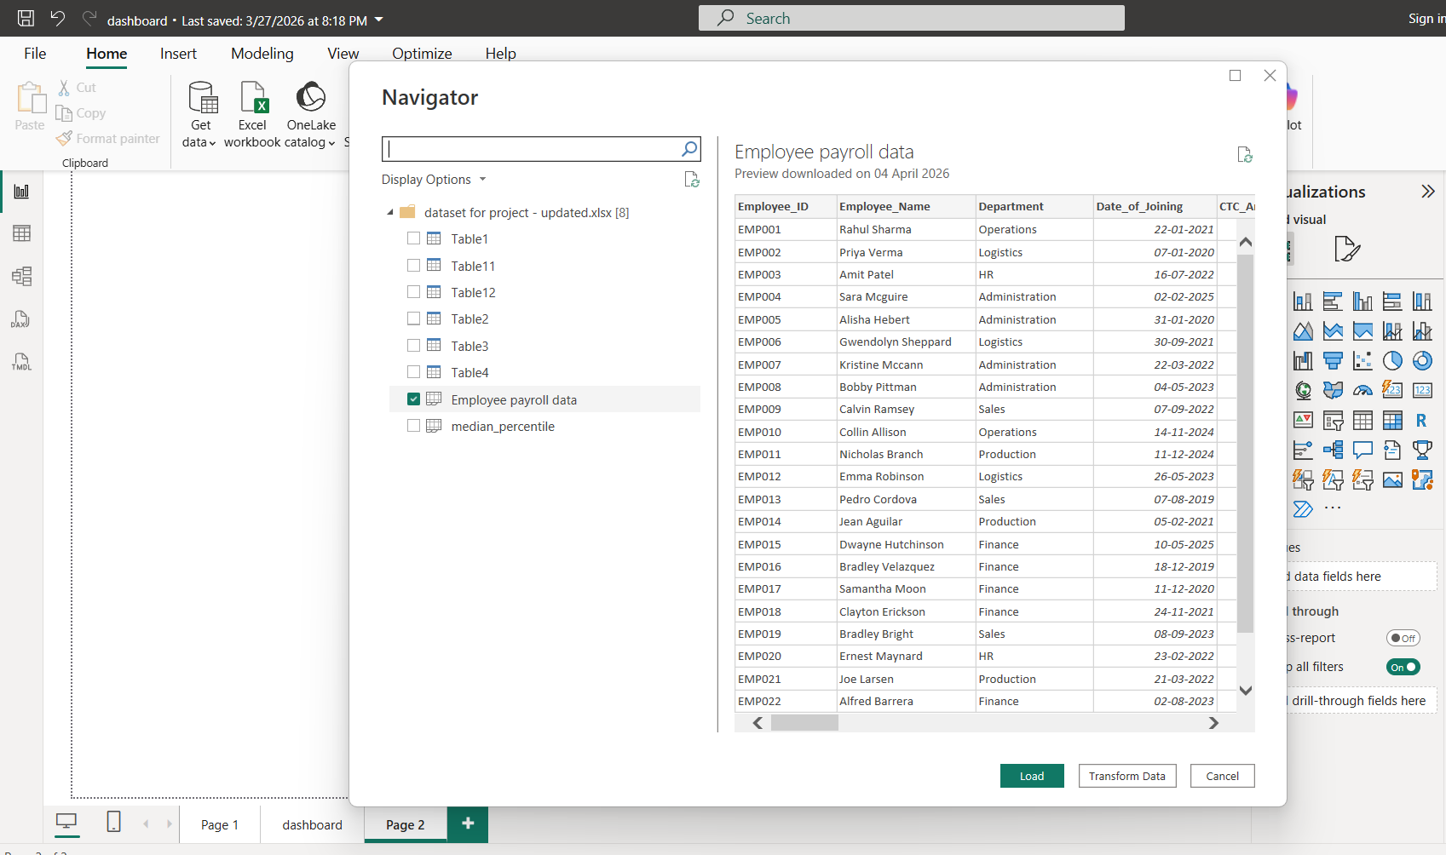
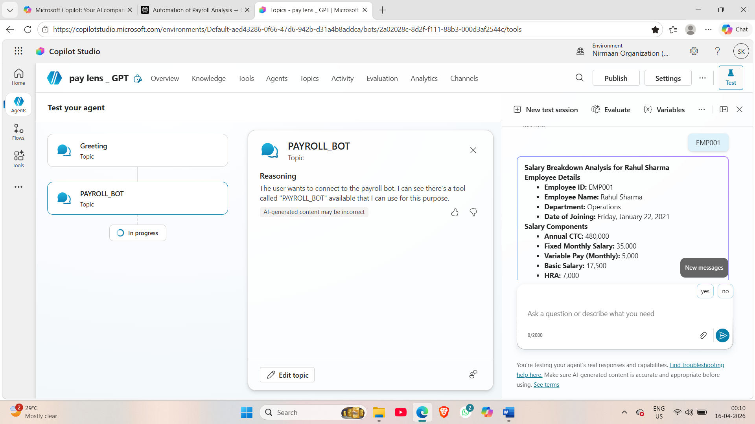
Live Demo of Project
Here's the list of some demo screenshots / features of the project:
Demo 1
Demo 2
Demo 3

Slide 10
Video of Project Demo
https://drive.google.com/file/d/1VPKu_8jVQDIYuchmSw_D6hoB72iISXag/view?usp=sharing
▶
[Insert your project demo video.
You can embed a video your live project.]

Slide 11
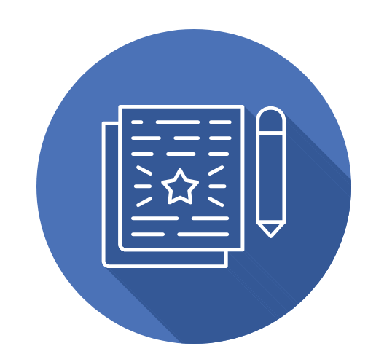
All links
Web application - Pay Lens AI
Azure portal – https://happy-sand-03668880f.7.azurestaticapps.net
Agent - Overview - pay lens _ GPT | Microsoft Copilot Studio
Chatbot - Topics - pay lens _ GPT | Microsoft Copilot Studio
Dashboard - https://app.powerbi.com/reportEmbed?reportId=1a98f1ac-1cd1-4e94-880f-00e0484eec27&autoAuth=true&ctid=aed43286-0f66-47d6-942b-d31a4b8addca
CONCLUSION

Slide 12
Conclusion
Intelligent Payroll Data Infrastructure
Automated Legal Alerts
Quantitative Pay Equity Framework
Financial Transparency for workforce
Decision – Intelligent Dashboard
Bridging transparency – skill - Analytical Gap.
Extension of live pay correction simulator
CONCLUSION

Slide 13

Future Scope
Extend solution to SMEs, startups, and educational institutions for payroll transparency.
Excel through Macros and VBA and power Query enabled.
Real-Time Data Integration
Predictive Analytics
Mobile App Interface
Multilingual Support
Automated Benchmarking

Slide 14
Thank You
AICW Fellowship | Student Project Presentation 2026
LinkedIn | Edunet Foundation

